Slide 1
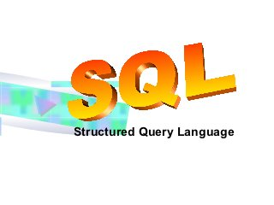

Slide 2
What is Database?
A database is a collection of information that is organized so that it can easily be accessed,managed and updated.

Slide 3
What Database consists of?
Database is collection of Tables
A table is a collection of related data entries and it consists of columns and rows
Each row is treated as Record

Slide 4
What is SQL?
SQL stands for Structued Query Language
SQL is used to communicate with a database
SQL can execute queries against a database
SQL can retrieve data from a database
SQL can insert records in a database
SQL can update records in a database
SQL can delete records from a database

Slide 5
WHAT IS SQL?
SQL is a data manipulation language.
SQL is not a programming language.
SQL commands are interpreted by the DBMS engine.
SQL commands can be used interactively as a query language within the DBMS.
SQL commands can be embedded within programming languages

Slide 6
SQL
SQL can create new databases
SQL can create new tables in a database
SQL can delete records from a database
SQL can create views in a database

Slide 7
DBMS INTRODUCTION
What is Database Management System?
It is a software through which we execute SQL queries
There are many such databases like- Oracle, Microsoft SQL Server, SQLite and many others

Slide 8
MYSQL
MYSQL is one of the Database management System
It is open source dbms and you can use it for free
Runs on various platforms and have good performance results
We will studying based on MYSQL

Slide 9
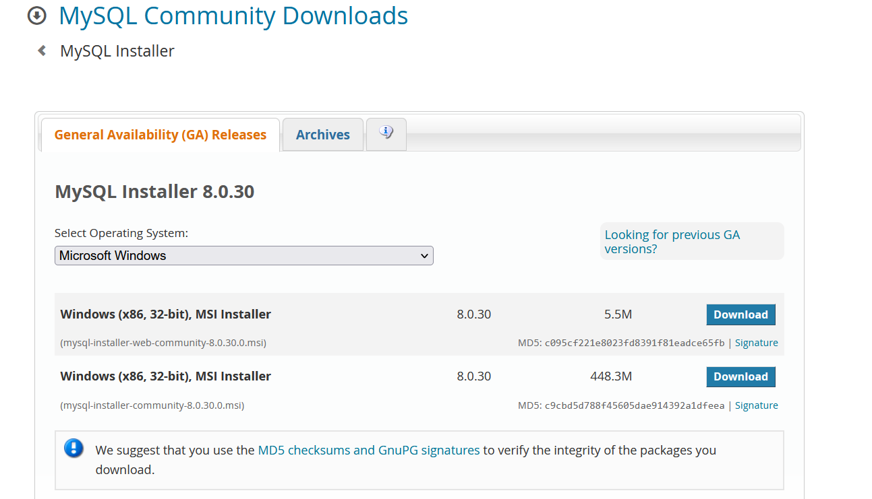
DOWNLOAD MYSQL
https://dev.mysql.com/downloads/windows/installer/

Slide 10
INSTALLATION STEPS

Slide 11
CREATE DATABASE
DATABASE IS LIKE A LAND FOR CONSTRUCTION OF BUILDING
WITHOUT LAND YOU CANNOT COSNTRUCT BUILDING
TO CREATE DATABASE USE BELOW QUERY
CREATE DATABASE DATABASE_NAME
FOR EG: CREATE DATABASE EMP;

Slide 12
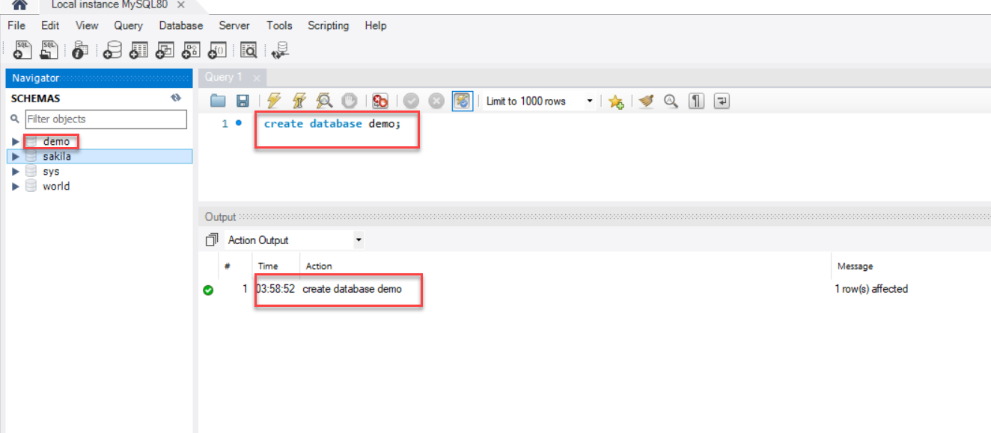
DATABASE

Slide 13
CREATE TABLE
FIRST MENTION WHICH DATABASE , TABLE SHOULD BE CREATED
SYNTAX: USE DATABASE_NAME;

Slide 14
CREATE TABLE

Slide 15
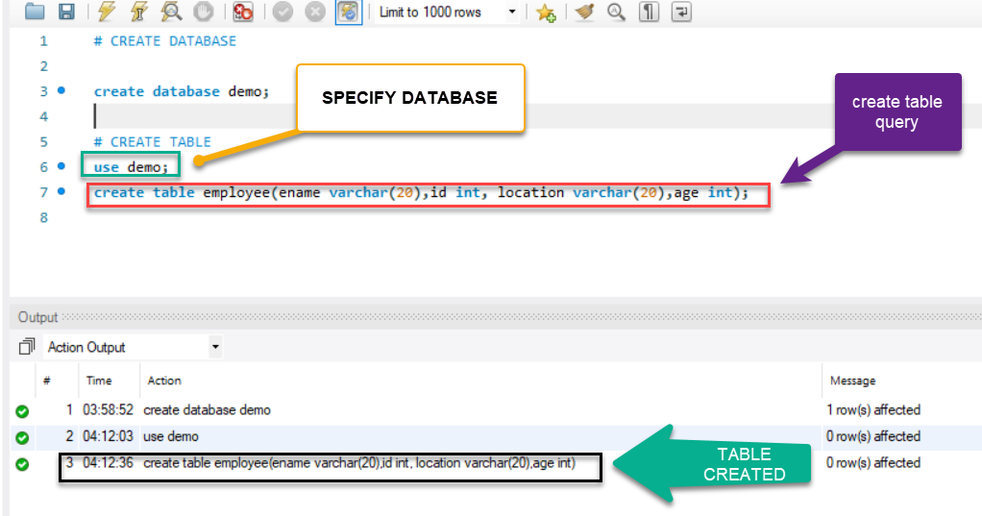
TABLE CREATION

Slide 16
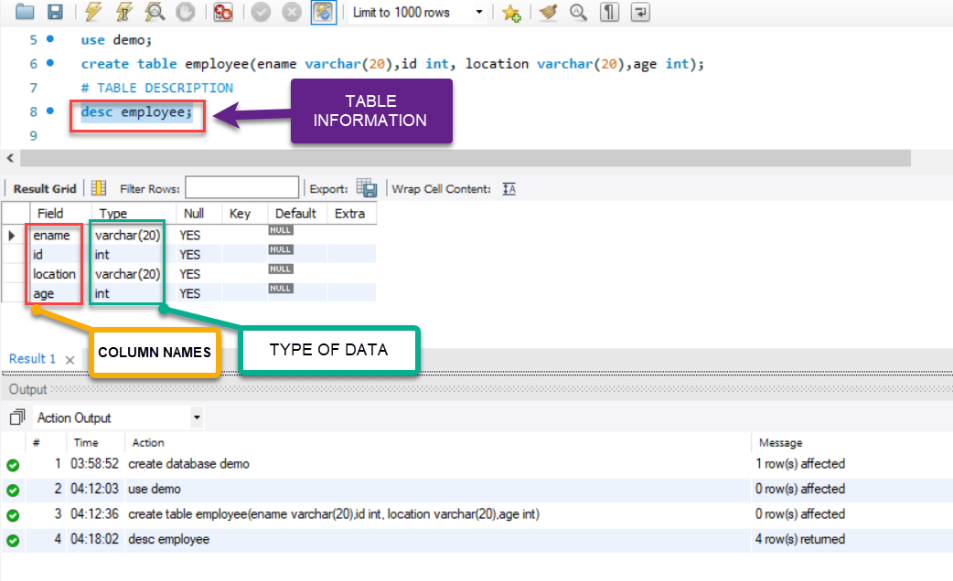
TABLE INFORMATION

Slide 17
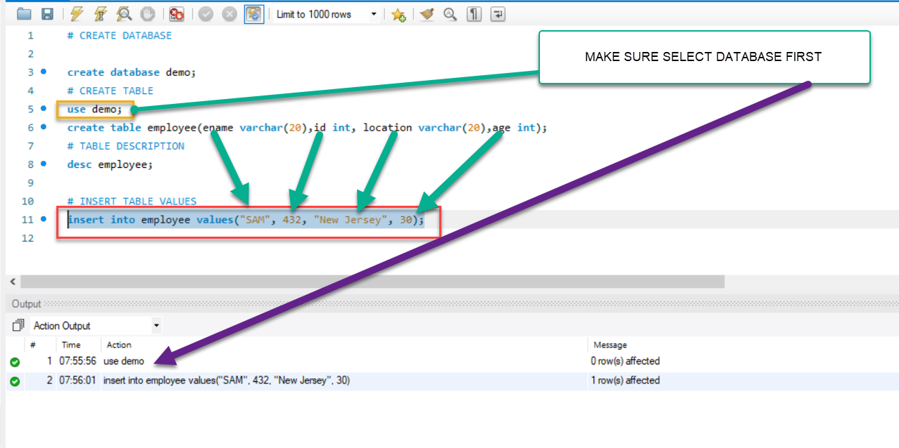
INSERT VALUES INTO TABLE

Slide 18
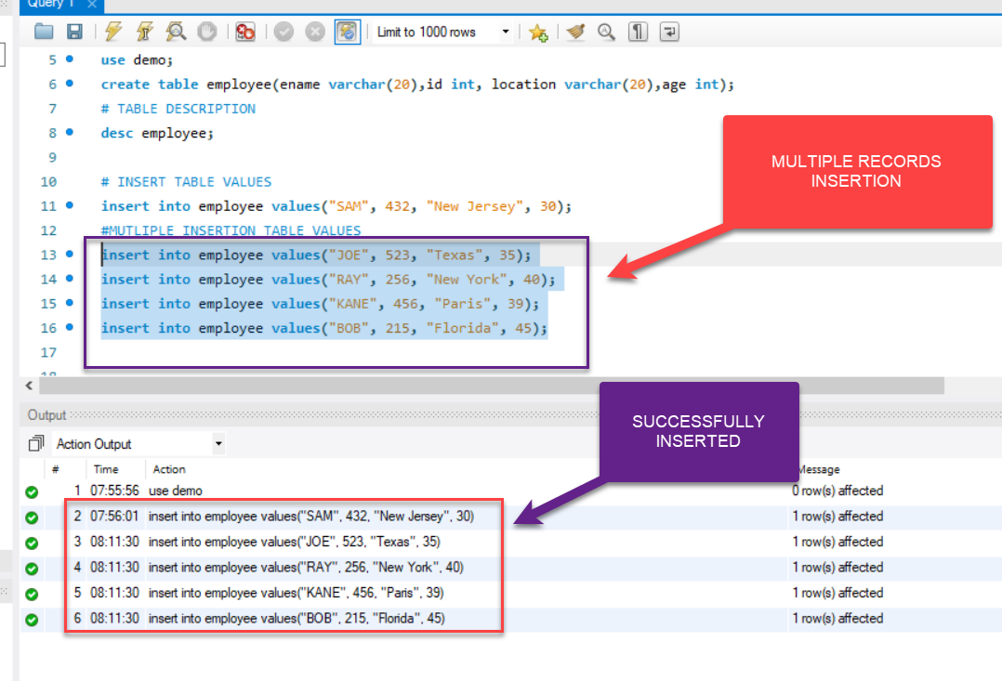
MUTLIPLE RECORD INSERTION

Slide 19
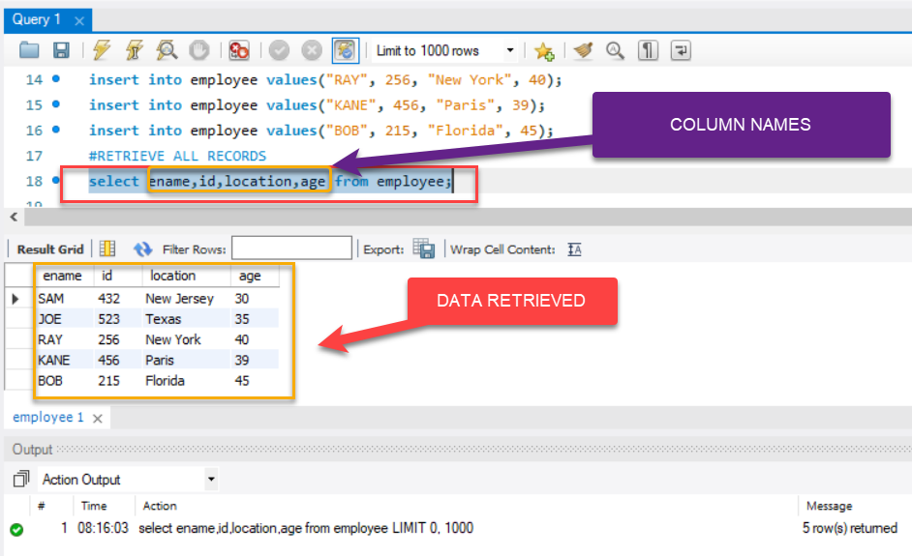
RETRIEVE ALL RECORDS

Slide 20
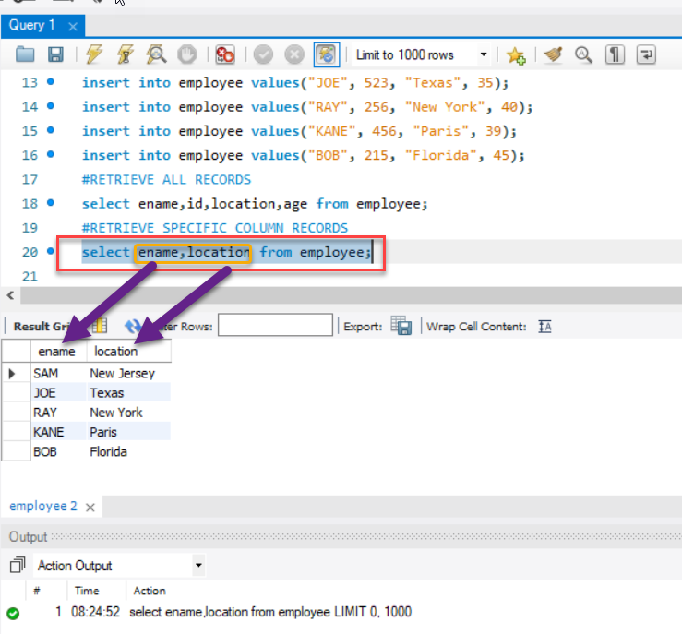
RETRIEVE SPECIFIC COLUMN RECORDS

Slide 21
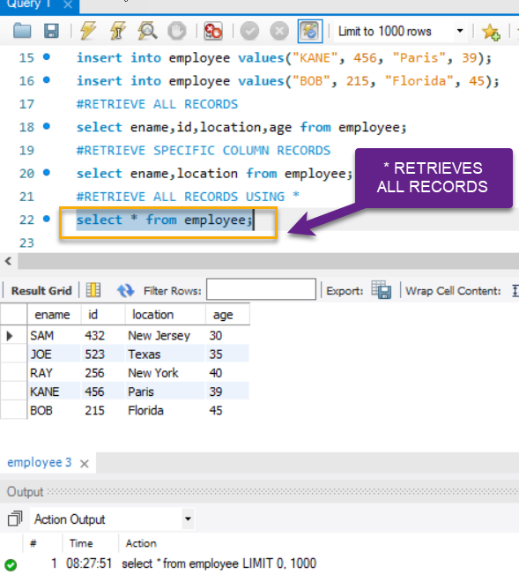
RETRIEVE ALL RECORDS USING *

Slide 22
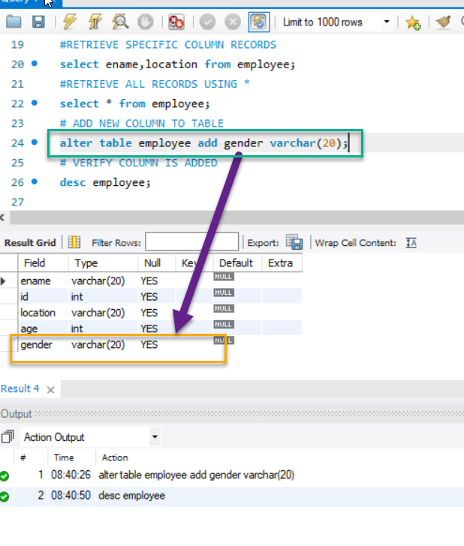
ADD COLUMN TO EXISTING TABLE
SYNTAX
ALTER TABLE TABLE_NAME ADD COLUMN_NAME DATATYPE;

Slide 23
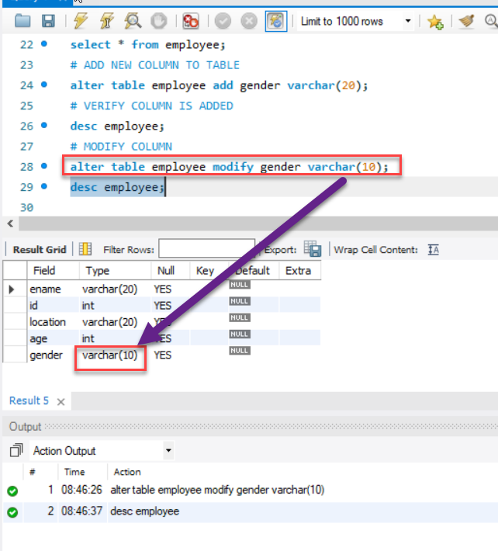
MODIFY COLUMN
SYNTAX
ALTER TABLE TABLE_NAME MODIFY COLUMN_NAME DATATYPE;

Slide 24
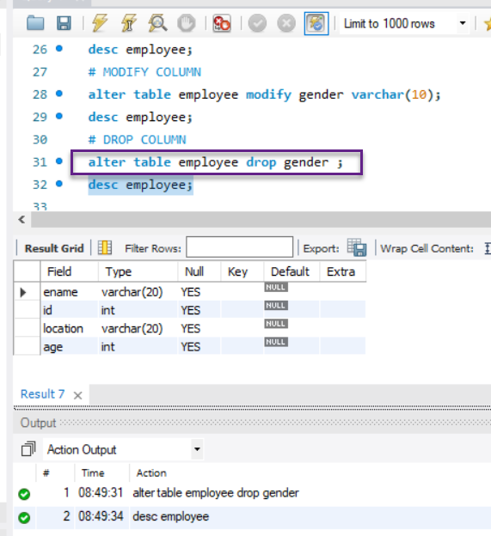
DROP COLUMN
SYNTAX
ALTER TABLE TABLE_NAME DROP COLUMN_NAME ;

Slide 25
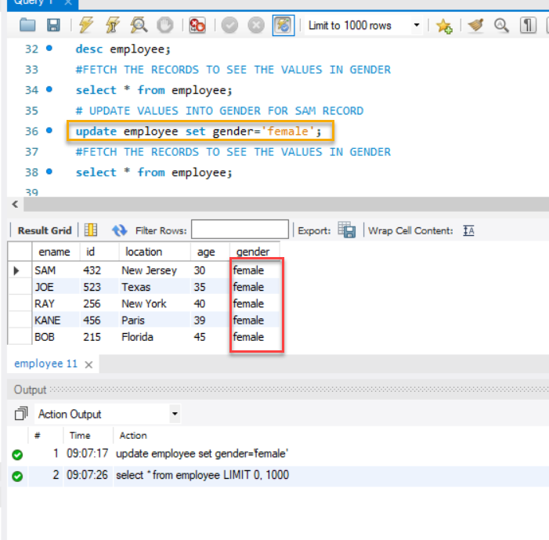
ADD VALUES(ROWS) TO COLUMN
SYNTAX
UPDATE TABLE TABLE_NAME SET COLUMN_NAME= VALUE
NOTE: IF WE DONT MENTION WHERE CONDITION ALL COLUMN VALUE WILL BE UPDATED

Slide 26
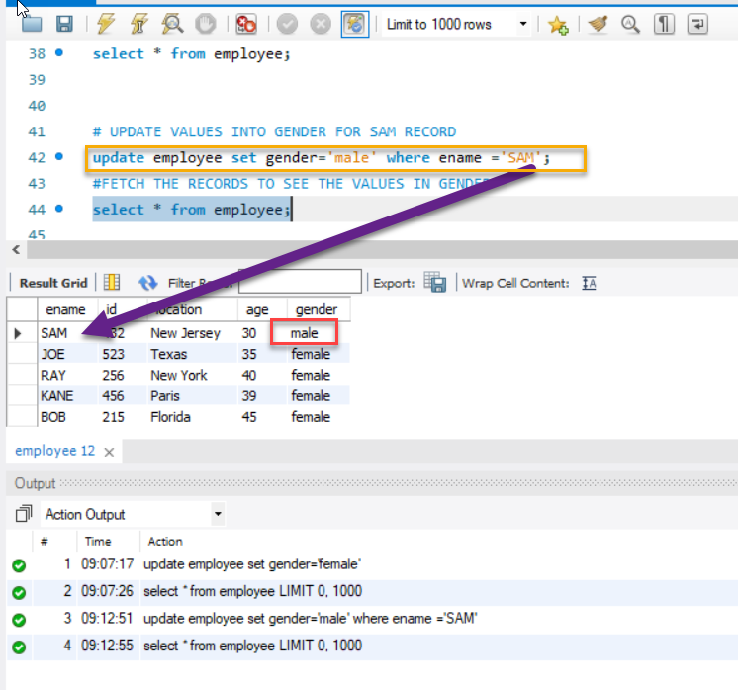
ADD VALUES(ROWS) TO SPECIFIC COLUMN
SYNTAX
UPDATE TABLE TABLE_NAME SET COLUMN_NAME= VALUE WHERE COLUMN_NAME=’VALUE’;
NOTE: IF WE DONT MENTION WHERE CONDITION ALL COLUMN VALUE WILL BE UPDATED

Slide 27
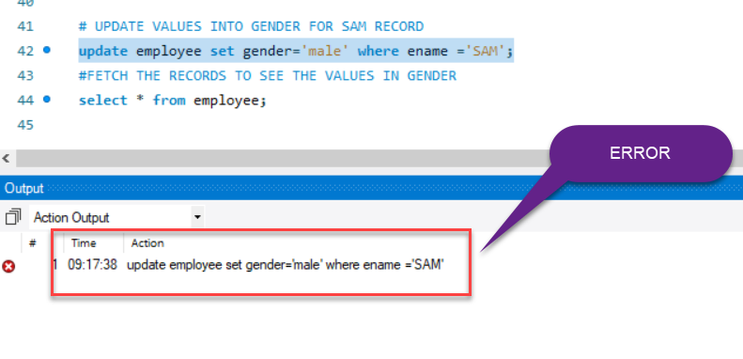
ERROR ON UPDATE

Slide 28
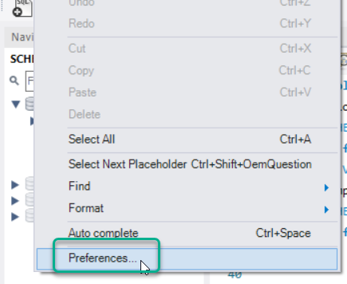
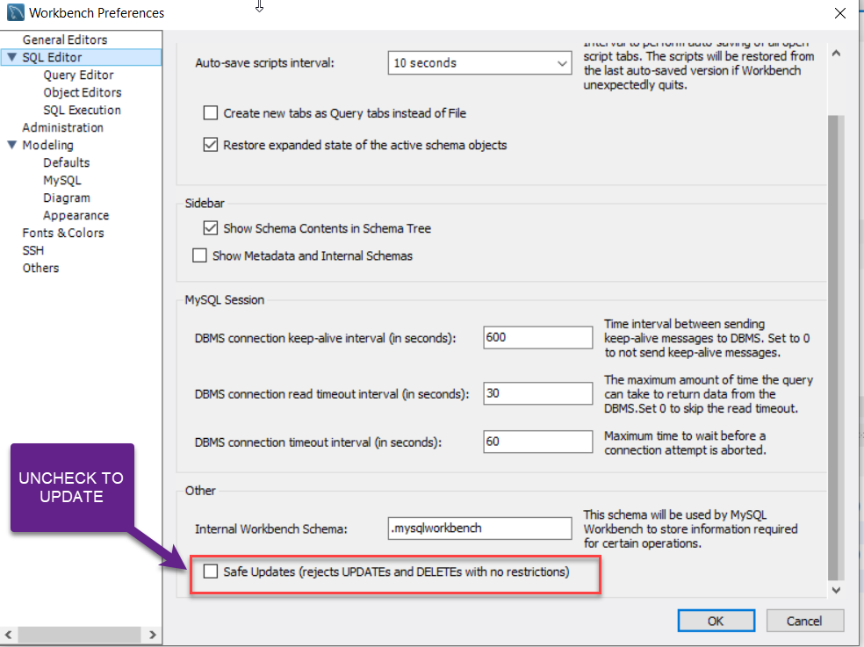
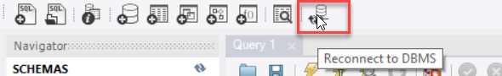
SOLUTION
EDIT -> PREFERENCES -> SQL Editor -> uncheck safe Updates-> OK-> Reconnect to DBMS

Slide 29
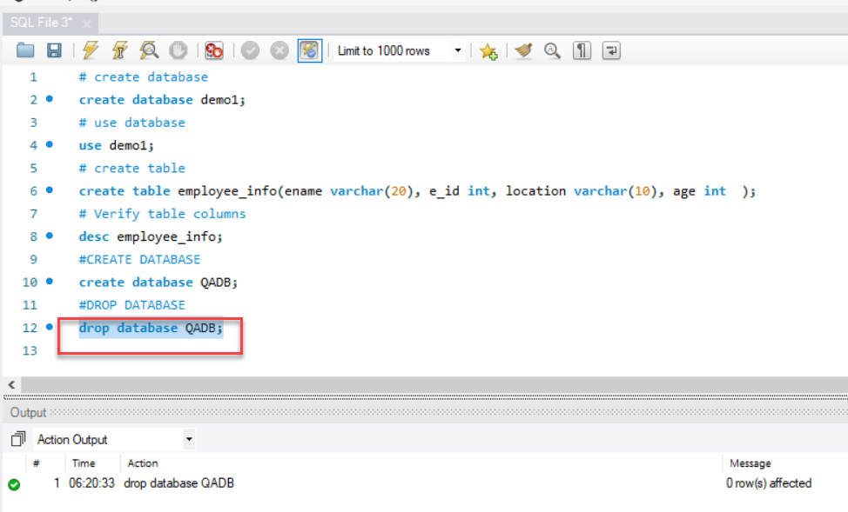
DROP DATABASE
SYNTAX
DROP DATABASE DATABASE_NAME;

Slide 30
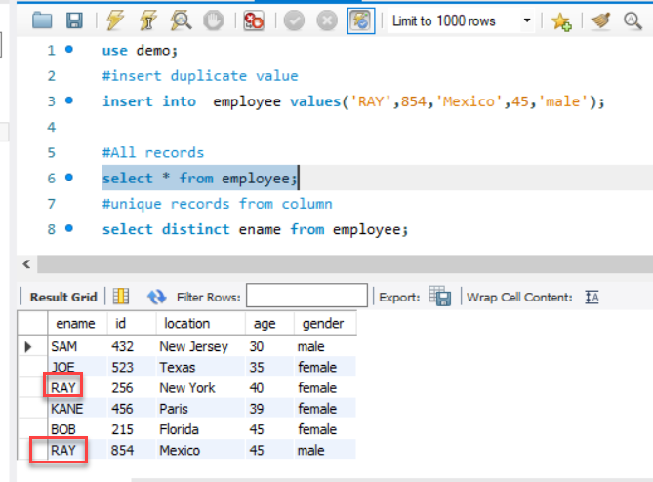
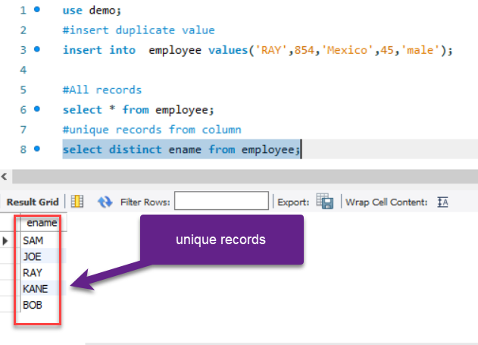
HOW TO GET UNQUE VALUES FROM COLUMN
Solution: If we need to find unique values from column we need to use ‘distinct’ keyword
Syntax: select distinct column_name from table;

Slide 31
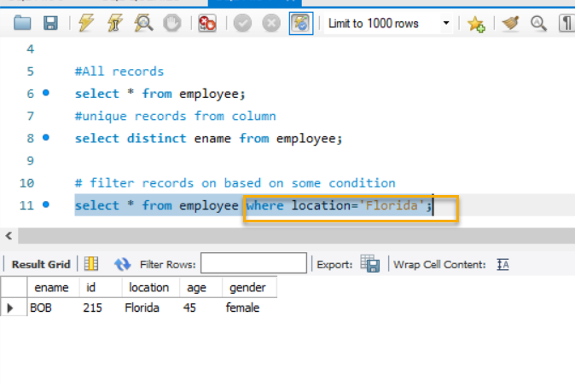
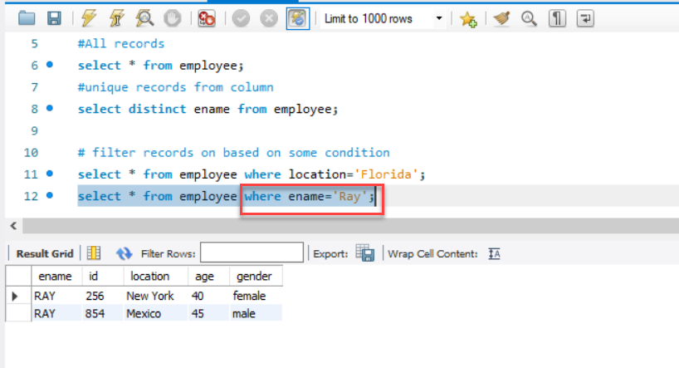
WHERE CONDITION
Syntax: select * from Table_Name where column_name=’value’;

Slide 32
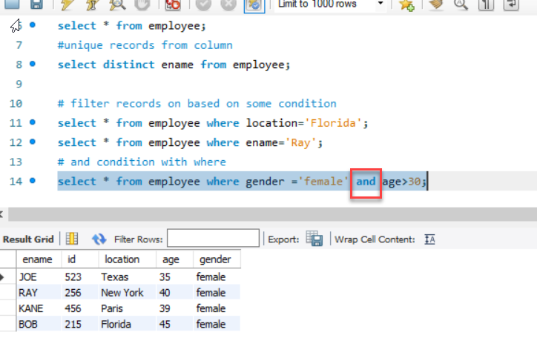
AND OPERATOR
AND IS USED WITH WHERE TO FILTER BOTH CONDITION MATCH

Slide 33
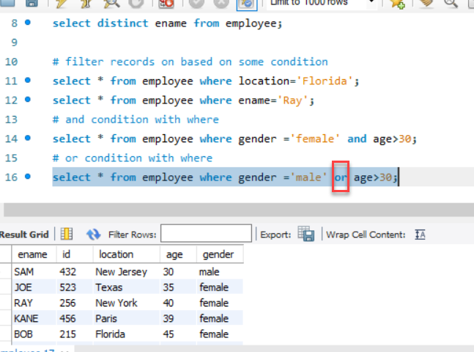
OR OPERATOR
OR IS USED WITH WHERE TO MATCH EITHER OF THE CONDITION

Slide 34
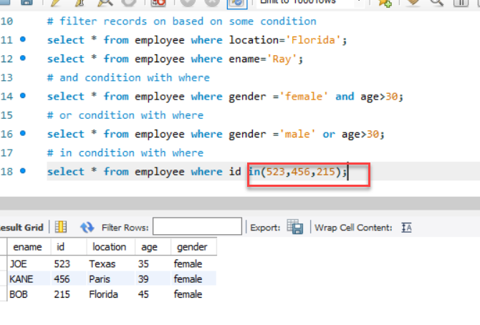
IN OPERATOR
IN IS USED WITH WHEN TO FILTER SPECIFIC VALUES

Slide 35
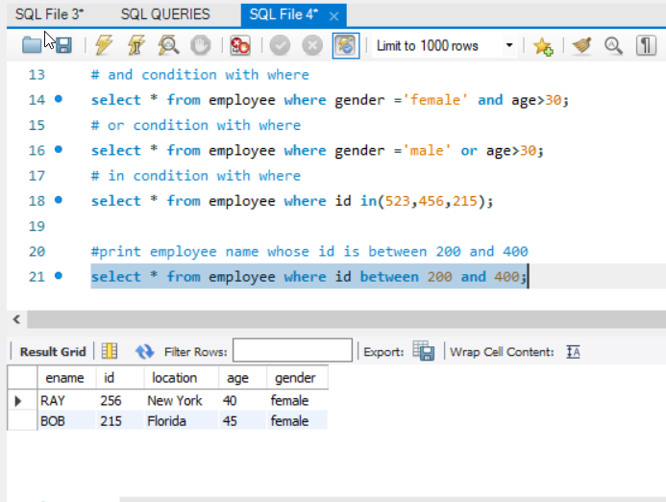
BETWEEN OPERATOR
BETWEEN IS USED WHEN YOU WANT TO FILTER RANGE OF VALUES( START & END)

Slide 36
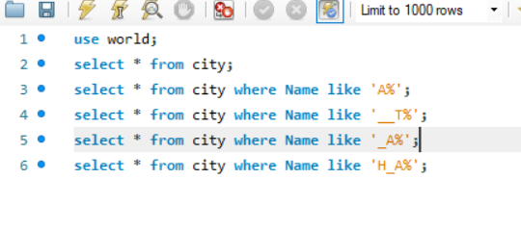
REGULAR EXPRESSIONS
% REPRESENTS ANY NUMBER OF CHARACTER
_ REPRESENTS ONE/SINGLE CHARACTER
NOTE: TO USE REGULAR EXPRESSION ALWAYS USE WITH LIKE

Slide 37
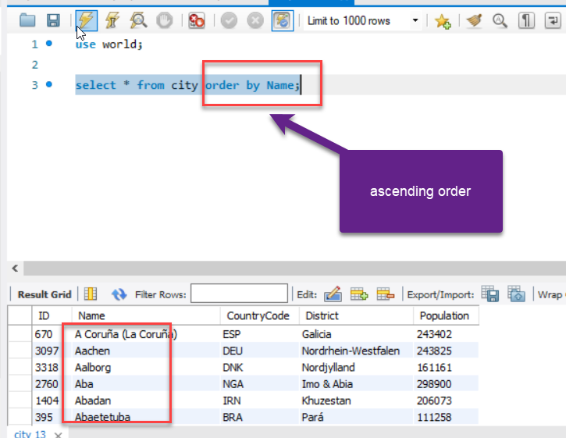
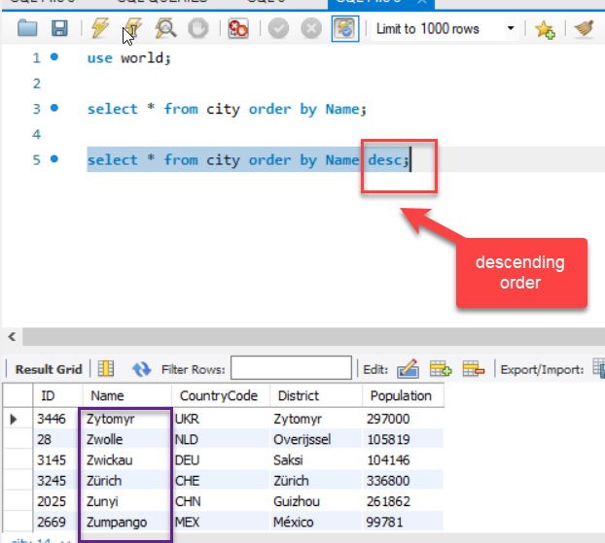
SORT

Slide 38
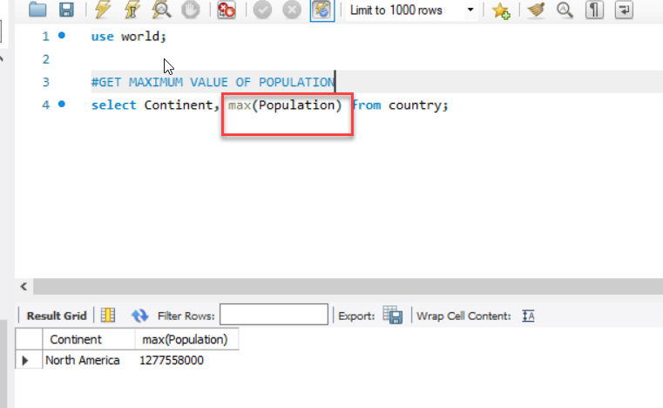
MAX KEYWORD
MAX KEYWORD WILL RETURN YOU THE MAXIMUM VALUE IN THE COLUMN

Slide 39
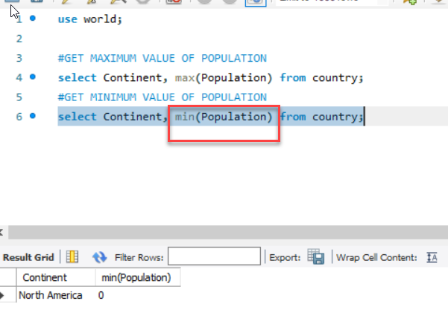
MIN KEWORD
MIN KEYWORD WILL RETURN YOU MINIMUM VALUE IN THE COLUMN

Slide 40
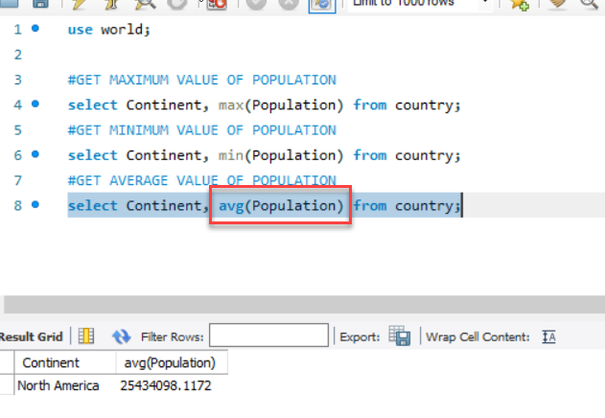
AVERAGE KEYWORD
AVG KEYWORD WILL RETURN YOU AVERAGE OF COLUMN VALUES

Slide 41
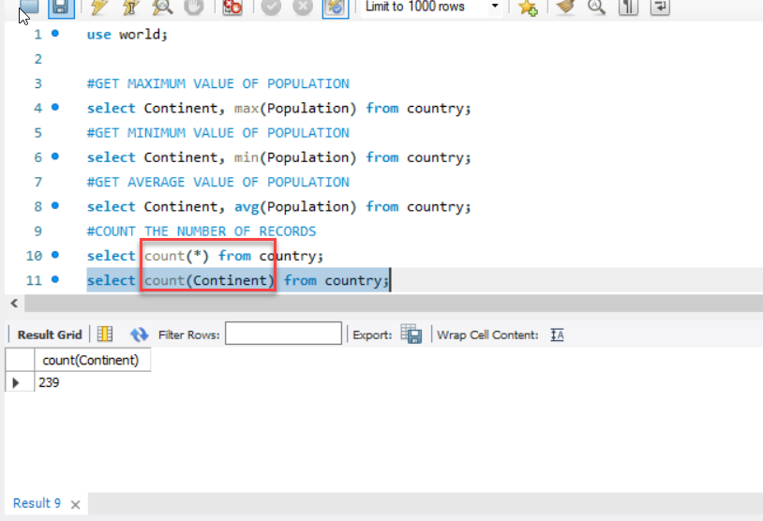
COUNT KEYWORD
COUNT KEYWORD WILL COUNT TOTAL VALUES PRESENT,
COUNT(*) WILL COUNT TOTAL ROWS PRESENT IN ALL COLUMNS
COUNT(COLUMN_NAME) WILL COUNT ROWS IN ONLY THAT PARTICULAR COLUMN

Slide 42
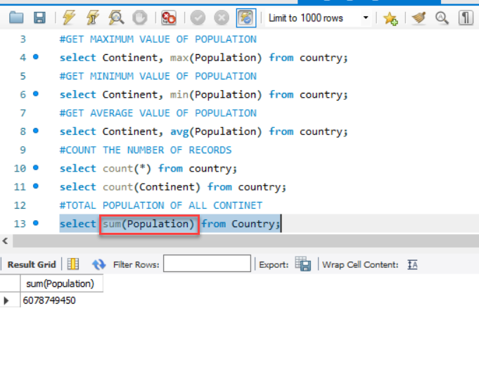
SUM KEYWORD
SUM KEYWORD WILL SUM TOTAL VALUES PRESENT IN THE COLUMN

Slide 43
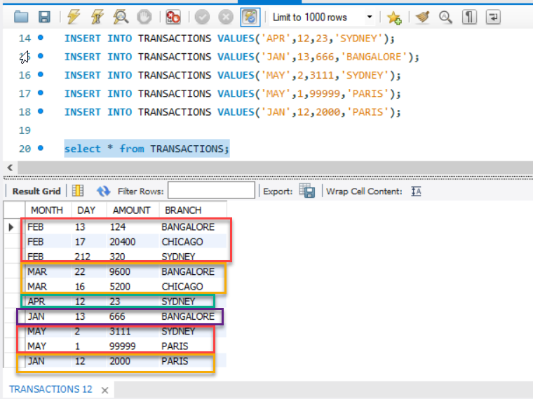
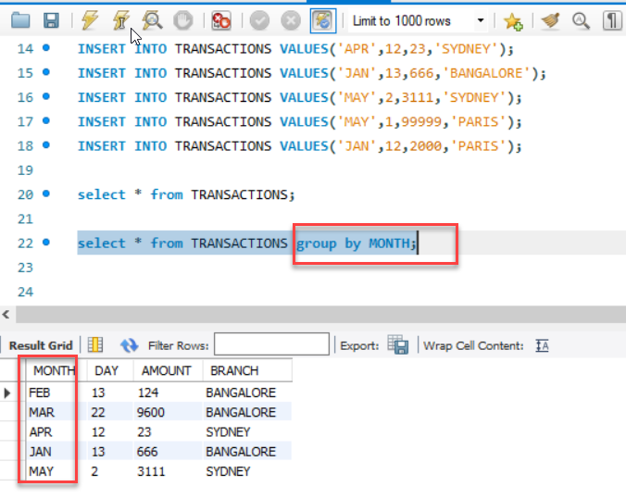
GROUP BY
GROUP BY WILL GROUP THE COLUMNS WITH SIMILAR VALUES AND RETURNS FIRST VALUE

Slide 44
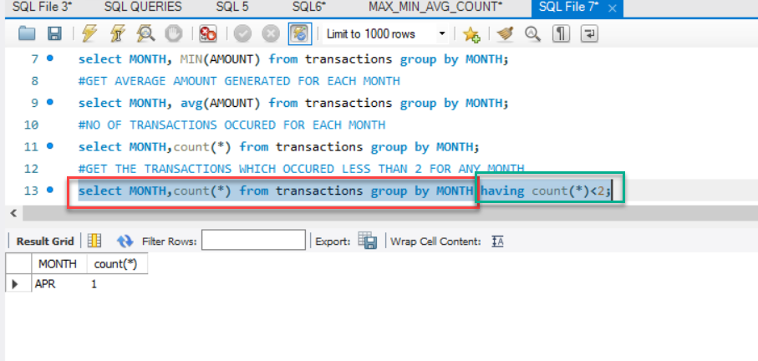
HAVING KEYWORD
HAVING KEYWORD IS USED WITH GROUP, WHEN YOU WANT FILTER RESULTS AFTER GROUP FUNCTION WE GO FOR HAVING KEYWORD

Slide 45
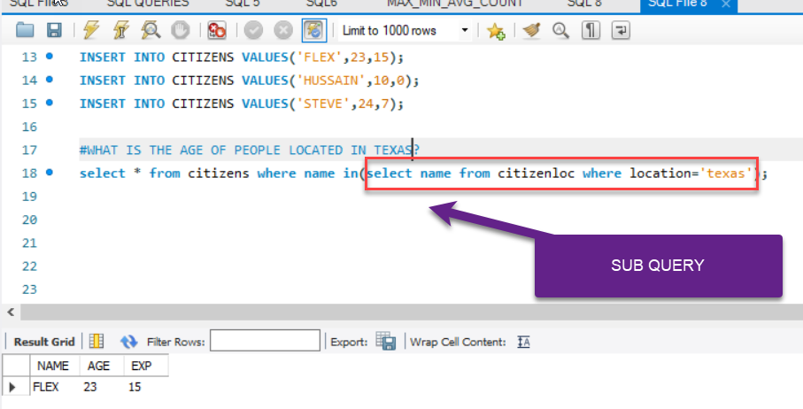
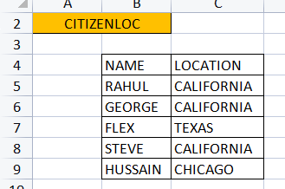
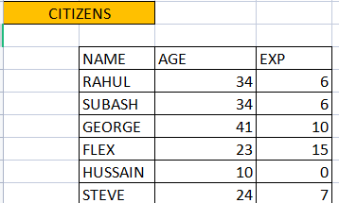
SUB QUERY
NOTE: IF SUBQUERY RETURNS MORE THAN ONE VALUE USE IN INSTEAD OF ‘=’

Slide 46
SQL JOINS
SQL Join statement is used to combine data or rows from two or more tables based on a common field between them

Slide 47
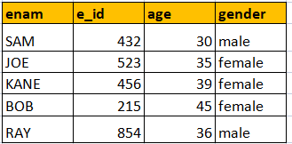
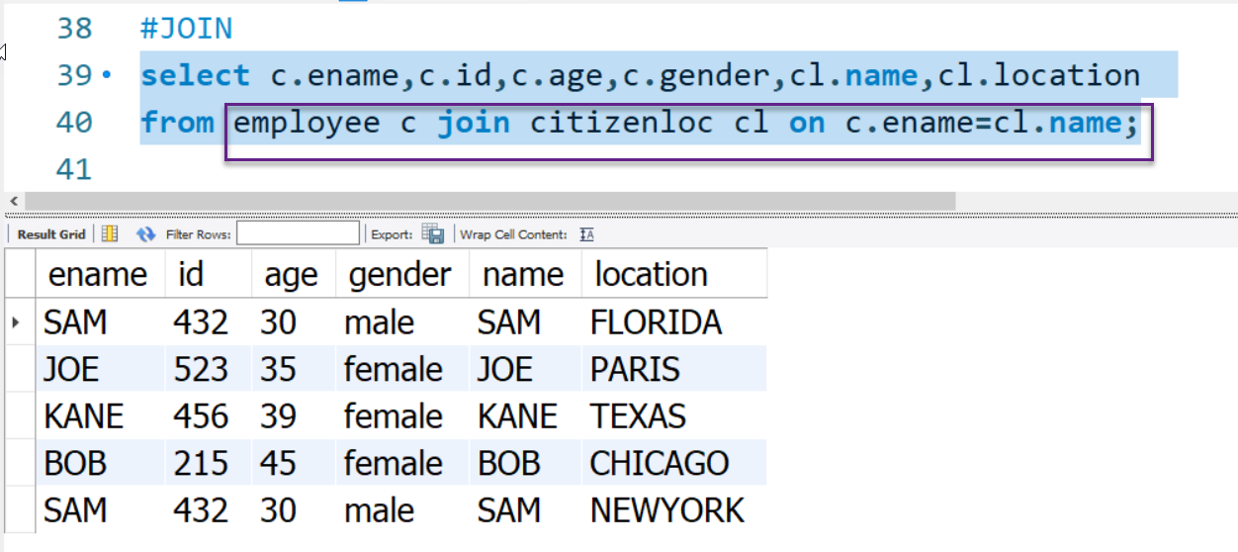
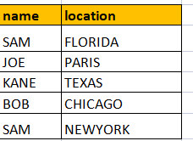

Slide 48
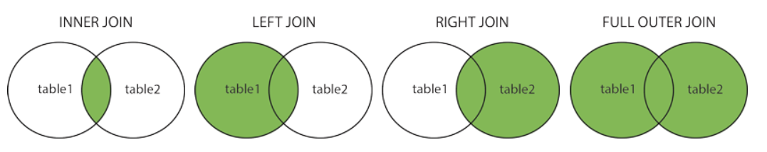
Different Types of SQL JOINs
(INNER) JOIN: Returns records that have matching values in both tables
LEFT (OUTER) JOIN: Returns all records from the left table, and the matched records from the right table
RIGHT (OUTER) JOIN: Returns all records from the right table, and the matched records from the left table
FULL (OUTER) JOIN: Returns all records when there is a match in either left or right table

Slide 49
INNER JOIN
The INNER JOIN keyword selects all rows from both the tables as long as the condition is satisfied. This keyword will create the result-set by combining all rows from both the tables where the condition satisfies i.e value of the common field will be the same.
Syntax:
SELECT table1.column1,table1.column2,table2.column1,....
FROM table1
INNER JOIN table2
ON table1.matching_column = table2.matching_column;
table1: First table.
table2: Second table
matching_column: Column common to both the tables.

Slide 50
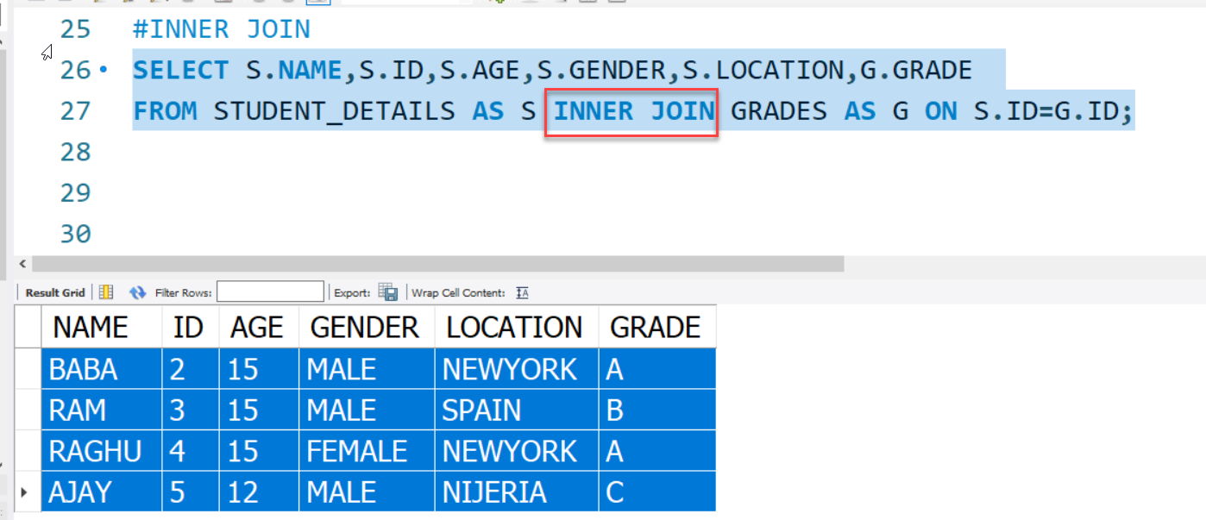
INNER JOIN

Slide 51
LEFT JOIN
This join returns all the rows of the table on the left side of the join and matches rows for the table on the right side of the join. For the rows for which there is no matching row on the right side, the result-set will contain null. LEFT JOIN is also known as LEFT OUTER JOIN.
Syntax:
SELECT table1.column1,table1.column2,table2.column1,....
FROM table1
LEFT JOIN table2
ON table1.matching_column = table2.matching_column;
table1: First table.
table2: Second table
matching_column: Column common to both the tables.

Slide 52
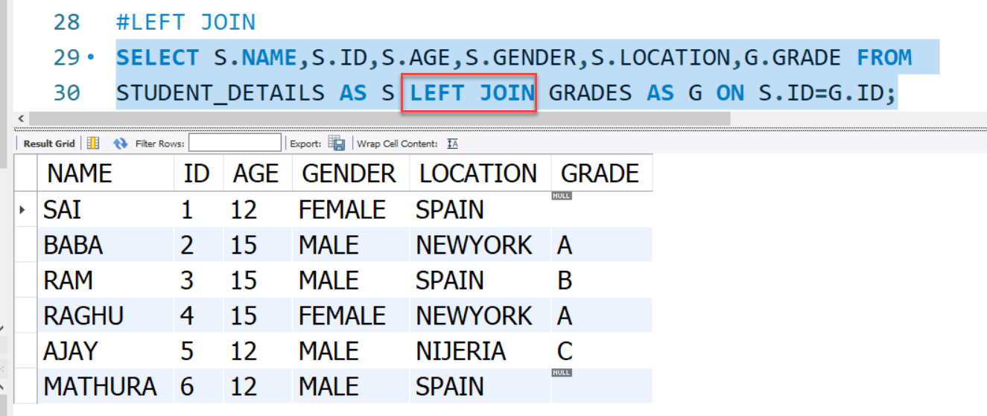
LEFT JOIN

Slide 53
RIGHT JOIN
RIGHT JOIN is similar to LEFT JOIN. This join returns all the rows of the table on the right side of the join and matching rows for the table on the left side of the join. For the rows for which there is no matching row on the left side, the result-set will contain null. RIGHT JOIN is also known as RIGHT OUTER JOIN.
Syntax:
SELECT table1.column1,table1.column2,table2.column1,....
FROM table1
RIGHT JOIN table2
ON table1.matching_column = table2.matching_column;
table1: First table.
table2: Second table
matching_column: Column common to both the tables.

Slide 54
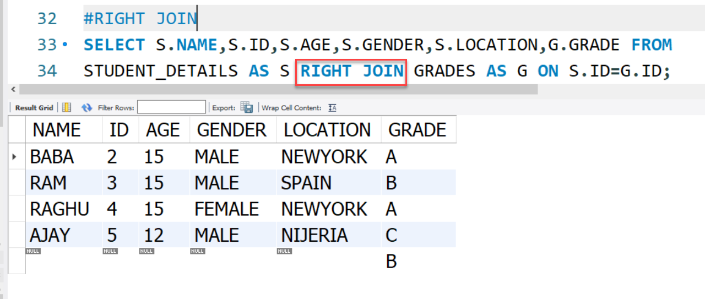
RIGHT JOIN

Slide 55
VIEWS IN SQL
A view contains rows and columns, just like a real table. The fields in a view are fields from one or more real tables in the database.
You can add SQL statements and functions to a view and present the data as if the data were coming from one single table.
SYNTAX
CREATE VIEW view_name AS
SELECT column1, column2, ...
FROM table_name
WHERE condition;

Slide 56
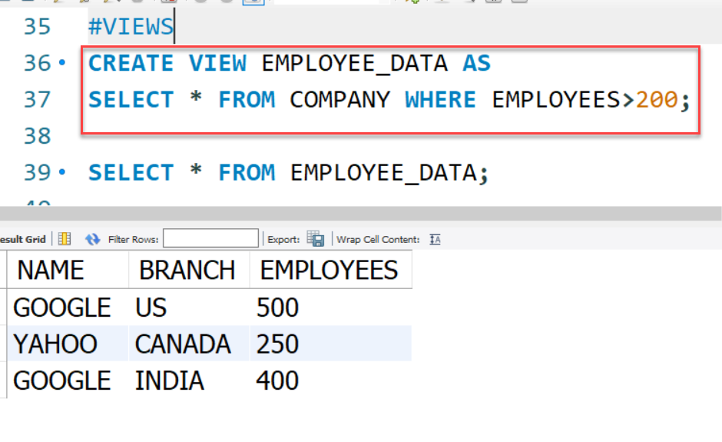
VIEWS EXAMPLE

Slide 57
SQL DROP TABLE
A SQL DROP TABLE statement is used to delete a table definition and all data from a table.
This is very important to know that once a table is deleted all the information available in the table is lost forever, so we have to be very careful when using this command.
SYNTAX
DROP TABLE "table_name";

Slide 58
DELETE RECORDS
The SQL DELETE Query is used to delete the existing records from a table.
You can use the WHERE clause with a DELETE query to delete the selected rows, otherwise all the records would be deleted.
SYNTAX
DELETE FROM table_name
WHERE [condition];

Slide 59
UPDATE RECORDS
The UPDATE statement is used to modify the existing records in a table.
SYNTAX
UPDATE table_name
SET column1 = value1, column2 = value2, ...
WHERE condition;

Slide 60
SQL NOT NULL CONSTRAINT
By default, a column can hold NULL values.
The NOT NULL constraint enforces a column to NOT accept NULL values.
This enforces a field to always contain a value, which means that you cannot insert a new record, or update a record without adding a value to this field.
EXAMPLE
CREATE TABLE Persons (
ID int NOT NULL,
LastName varchar(255) NOT NULL,
FirstName varchar(255) NOT NULL,
Age int
);

Slide 61

SQL NOT NULL CONSTRAINT

Slide 62
SQL UNIQUE CONSTRAINT
The UNIQUE constraint ensures that all values in a column are different.
Both the UNIQUE and PRIMARY KEY constraints provide a guarantee for uniqueness for a column or set of columns.
A PRIMARY KEY constraint automatically has a UNIQUE constraint.
However, you can have many UNIQUE constraints per table, but only one PRIMARY KEY constraint per table.
EXAMPLE
CREATE TABLE Persons (
ID int NOT NULL UNIQUE,
LastName varchar(255) NOT NULL,
FirstName varchar(255),
Age int
);

Slide 63

SQL UNIQUE CONSTRAINT

Slide 64
SQL DEFAULT CONSTRAINTS
The DEFAULT constraint is used to set a default value for a column.
The default value will be added to all new records, if no other value is specified.
SYNTAX
CREATE TABLE Persons (
ID int NOT NULL,
LastName varchar(255) NOT NULL,
FirstName varchar(255),
Age int,
City varchar(255) DEFAULT 'Sandnes'
);

Slide 65

SQL DEFAULT CONSTRAINTS

Slide 66
PRIMARY KEY
The PRIMARY KEY constraint uniquely identifies each record in a table.
Primary keys must contain UNIQUE values, and cannot contain NULL values.
A table can have only ONE primary key; and in the table, this primary key can consist of single or multiple columns (fields).
SYNTAX
CREATE TABLE Persons (
ID int NOT NULL,
LastName varchar(255) NOT NULL,
FirstName varchar(255),
Age int,
PRIMARY KEY (ID)
);

Slide 67

PRIMARY KEY

Slide 68
FOREIGN KEY
The FOREIGN KEY constraint is used to prevent actions that would destroy links between tables.
A FOREIGN KEY is a field (or collection of fields) in one table, that refers to the PRIMARY KEY in another table.
The table with the foreign key is called the child table, and the table with the primary key is called the referenced or parent table.
SYNTAX
CREATE TABLE Persons (
ID int NOT NULL,
LastName varchar(255) NOT NULL,
FirstName varchar(255),
Age int,
PRIMARY KEY (ID)
);

Slide 69

FOREIGN KEY

Slide 93
WHAT IS SQL?
SQL is a data manipulation language.
SQL is not a programming language.
SQL commands are interpreted by the DBMS engine.
SQL commands can be used interactively as a query language within the DBMS.
SQL commands can be embedded within programming languages

Slide 94
3 Types of SQL Commands
Data Definition Language (DDL):
Commands that define a database - Create, Alter, Drop
Data Manipulation Language (DML)
Commands that maintain and query a database.
Data Control Language (DCL)
Commands that control a database, including administering privileges and committing data.

Slide 95

DDL, DML, DCL, and the database development process

